Slide 1
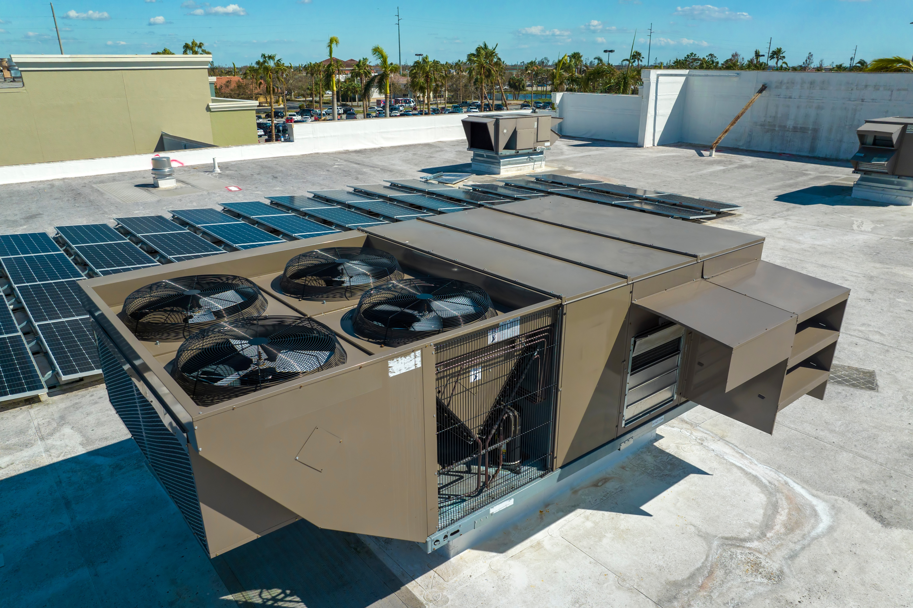
Reach Code for Existing Nonresidential Buildings:
Single Zone Rooftop HVAC Replacements and Installations
    [Jurisdiction and Date]
Notes:
Images from free image websites Unsplash and Pexels.

Slide 2

Agenda
Objectives and Scope
Background & Policy Context
Proposed Policy Requirements & Exceptions
Development Process and Next Steps
Ways to Provide Feedback
Q&A Discussion
Notes:
Image source: Stock

Slide 3
Objectives and Scope

Slide 4


Ordinance Objectives
Require energy upgrades when replacing or adding a single zone rooftop HVAC unit
  Upgrade to an electric heat pump space conditioner and comply with State Code
  Install air-cooled air conditioner and make additional energy improvements
Meet Federal and State requirements
  Electric heat pump is not required, but encouraged

Slide 5
Background and Context

Slide 6
Policy Context
Local Policy
Cite CAP (or other policy document) regarding existing buildings
Recite history, other reach codes

Slide 7
Context: GHG Emissions Projections 2030 [use local data]
Existing Nonresidential Buildings: Gas
Existing Nonresidential Buildings: Electricity
Notes:
Edit with local data

Slide 8
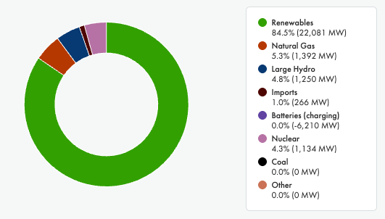
Why Go All-Electric?
Power Supply Mix in CA – An Instantaneous Snapshot
Source: https://www.caiso.com/todays-outlook, May 10, 2025
Notes:
Image source: CAISO

Slide 9
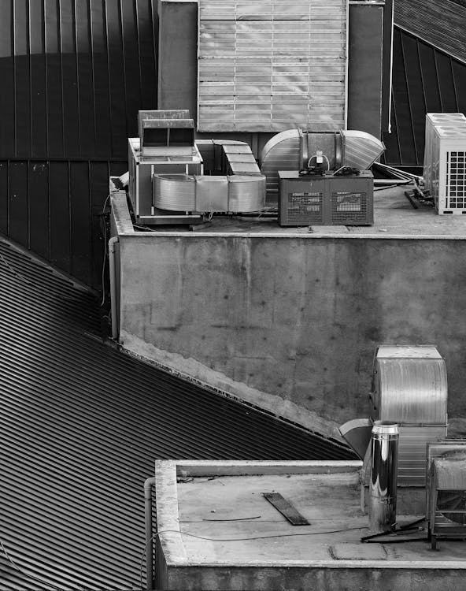
Why Heat Pumps?
Heat pumps result in major greenhouse gas emission reductions
  Two to four times more efficient than gas furnaces
  Powered by electricity, which in California, is mostly from renewable energy sources
Can be both an air conditioner and a space heater
No on-site combustion of gas
No risk of carbon monoxide poisoning from the space conditioning system

Slide 10

HVACs in Existing [Jurisdiction] Buildings
XX existing nonresidential buildings
YY with single zone HVAC
ZZ annual permits for HVAC replacements between 5 and 20 tons
AA projects affected by proposed requirements
[use local data]

Slide 11
Policy Development Timeline
[Date]
Community Engagement
[Date]
2nd Council
Reading
[Date]
1st Council Reading
[Date]
File with CEC & CBSC
[Date]
Code takes effect
[Date]
[Name of commissions/committees]

Slide 12
Proposed Policy Requirements

Slide 13
State Energy Code
Note: Slide applicable to CZs 3-13 and 15
Retail, Grocery, Schools, Office, Financial Institutions, Libraries
New Construction - 140.4(a)2
  Units 20 tons or less
    Heat pump
Additions and Alterations - 141.0(b)2C
  Units 5 tons or less
    Heat pump or
    Air conditioner plus variable speed fan and economizer

Slide 14
State Energy Code (alt)
Note: Slide applicable to CZs 1, 2, 14 & 16
Retail, Grocery, Schools, Office, Financial Institutions, Libraries
New Construction - 140.4(a)2
  Units 20 tons or less, with certain exceptions
    Heat pumps
Additions and Alterations - 141.0(b)2C
  Units 5 tons or less, with certain exceptions
    Heat pumps or
    Furnace plus variable speed fan and economizer

Slide 15
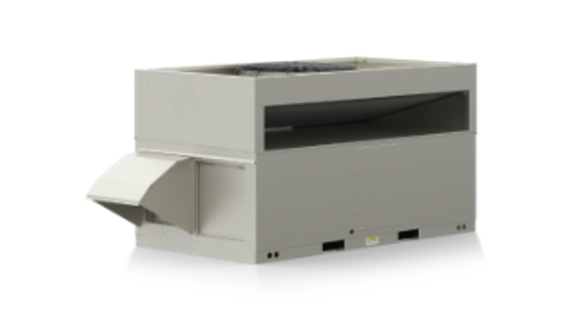
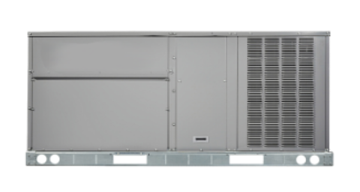
Policy at a Glance
When replacing or adding a single zone rooftop HVAC unit that is less than 20 [10, in certain climate zones] tons, either:
  Install a heat pump to provide both space heating and cooling) and meet State code requirements that apply to the project, OR
  Install an air conditioner, meet State code requirements that apply to the project AND
    Install heat recovery ventilation
    Install demand control ventilation [delete if this doesn’t apply to local climate zone]
Notes:
State code requires variable speed fan and economizer as well.

Slide 16

Definitions (delete DCV if not applicable)
Heat Recovery Ventilation (HRV): A ventilation system that recovers energy by operating between two air sources at different temperatures. It is used to reduce the heating and cooling demands of buildings.
Demand Control Ventilation (DCV): A feedback control method to maintain indoor air quality that automatically adjusts the ventilation rate provided to a space in response to changes in conditions such as occupant number or indoor pollutant concentration. This control strategy is mainly intended to reduce the energy used by HVAC systems compared to those of buildings that use open-loop controls with constant ventilation rates. (delete if not applicable)
Source: Wikipedia
Notes:
State code requires variable speed fan and economizer as well.

Slide 17
RTU Reach Codes Framework
Trigger
  New or replacement single zone AC in existing buildings
Primary Pathway - Heat pump
  Must be cost-effective
Alternative Pathway - Furnace + HRV + DCV[if applicable]
  Must achieve energy equivalency by meeting or exceeding the energy savings of the primary pathway

Slide 18
GHG Reductions: Metric Tons (first year) by Vintage
Small Office (5,500 sf) | Pre-1990 | 1990s | 2000s
Heat Pump
Air Conditioner + HRV [+DCV if applicable]
Medium Retail (25,000 sf) | Pre-1990 | 1990s | 2000s
Heat Pump
Air Conditioner + HRV [+DCV if applicable]
Populate using data from Reference Table 2. Alternate – provide range instead of values by vintage.

Slide 19
Considerations for Application of Results
HRV and DCV are readily available and easy to install
HRV and DCV are used for energy equivalency, not cost-effectiveness
All occupancies in Section 141.0(b)2Cii have similar schedules
Precedence for extrapolating results to other building types
Permit applicants most often use the prescriptive path to document compliance with equipment changeouts
Delete references to DCV if not applicable to local climate zone

Slide 20

Exceptions
If the existing main electrical panel does not have the capacity for a heat pump but can support a new or replacement air conditioner
  (exceptions 2-5 only apply if DCV is required)
Spaces where fewer than 25 people are expected per 1,000 square feet, and the ventilation system does not include:
  an air economizer; or
  adjustable outside air control; or
  design outdoor airflow rate over 3,000 cfm

Slide 21
Exceptions, cont.
h
h
When the space exhaust is greater than the design ventilation rate, minus 0.2 cfm for each square foot of conditioned area.
Spaces without local exhaust ventilation that have operations generating fumes shall not install demand control ventilation.
Spaces with an occupancy of less than 10 people, or smaller than 150 square feet.

Slide 22
Resources
2025 Nonresidential Alterations: Reach Code Study and Data
  https://localenergycodes.com/content/resources
View results for individual jurisdictions in the Cost-Effectiveness Explorer tool:
  https://explorer.localenergycodes.com/

Slide 23
Ways to Provide Feedback

Slide 24

Stakeholder and Community Engagement
[Provide details on outreach and engagement activities]

Slide 25
Q & A Discussion

Slide 26
Thank you!
  We appreciate your time
  Name
    email
  Name
    email
url

Slide 27
Reference Table 1:
Use to populate requirements slide
Climate Zone | 5-10 tons | >10-20 tons
CZ 1 | Heat pump or furnace with HRV and DCV | No requirement
CZ 2 | Heat pump or furnace with HRV and DCV | Heat pump or furnace with HRV and DCV
CZ 3 | Heat pump or furnace with HRV | Heat pump or furnace with HRV
CZ 4 | Heat pump or furnace with HRV | Heat pump or furnace with HRV
CZ5/PGE | Heat pump or furnace with HRV | Heat pump or furnace with HRV
CZ5/SCG | Heat pump or furnace with HRV | No requirement
CZ6 | Heat pump or furnace with HRV and DCV | No requirement
CZ7 | Heat pump or furnace with HRV and DCV | No requirement
CZ8 | Heat pump or furnace with HRV and DCV | No requirement
CZ9 | Heat pump or furnace with HRV and DCV | No requirement
CZ10 | Heat pump or furnace with HRV and DCV | No requirement
CZ11 | Heat pump or furnace with HRV | Heat pump or furnace with HRV
CZ12 | Heat pump or furnace with HRV | No requirement
CZ13 | Heat pump or furnace with HRV | No requirement
CZ14 | Heat pump or furnace with HRV | No requirement
CZ15 | Heat pump or furnace with HRV | No requirement
CZ16 | Heat pump or furnace with HRV | Heat pump or furnace with HRV

Slide 28
Reference Table 2:
Use to populate GHG slide
Occupancy | Measure2 | Vintage | CZ01 | CZ02 | CZ03 | CZ04 | CZ05 | CZ06 | CZ07 | CZ08 | CZ09 | CZ10 | CZ11 | CZ12 | CZ13 | CZ14 | CZ15 | CZ16
Small Office | Heat Pump | 1980 | 3.2 | 2.1 | 0.5 | 0.7 | 0.6 | 0.2 | 0.1 | 0.2 | 0.3 | 0.3 | 0.9 | 0.8 | 0.7 | 2.1 | 0.5 | 4.2
Small Office | Furnace and HRV | 1980 | 1.7 | 1.0 | 0.3 | 0.4 | 0.3 | 0.1 | 0.1 | 0.1 | 0.1 | 0.1 | 0.4 | 0.4 | 0.3 | 1.1 | 0.3 | 0.7
Small Office | Heat Pump | 1990 | 1.9 | 1.0 | - | - | - | - | - | 0.1 | 0.2 | 0.2 | - | - | - | 1.0 | - | 2.0
Small Office | Furnace and HRV | 1990 | 1.3 | 0.5 | - | - | - | - | - | 0.1 | 0.1 | 0.1 | - | - | - | 0.7 | - | 0.1
Small Office | Heat Pump | 2000 | 2.2 | 1.2 | - | - | - | - | - | - | - | - | - | - | - | 1.2 | - | 2.3
Small Office | Furnace and HRV | 2000 | 1.5 | 0.7 | - | - | - | - | - | - | - | - | - | - | - | 0.8 | - | 0.0
Medium Retail | Heat Pump | 1980 | 12.7 | 9.2 | 7.4 | 8.4 | 6.9 | 3.1 | 2.5 | 3.1 | 3.8 | 3.8 | 9.7 | 8.9 | 7.1 | 8.4 | 2.1 | 14.7
Medium Retail | Furnace and HRV | 1980 | 4.8 | 3.5 | 2.7 | 3.0 | 2.8 | 1.2 | 1.1 | 1.2 | 1.5 | 1.6 | 3.0 | 3.1 | 2.6 | 2.7 | 0.8 | 3.7
Medium Retail | Furnace, HRV & DCV | 1980 | 6.6 | 5.3 | 3.8 | 4.6 | 3.8 | 1.5 | 1.3 | 1.6 | 2.1 | 2.1 | 5.0 | 4.9 | 4.1 | 4.2 | 1.2 | 6.7
Medium Retail | Heat Pump | 1990 | 9.9 | 6.4 | 5.3 | 5.9 | 4.9 | 2.0 | 1.6 | 2.0 | 2.6 | 2.6 | 6.6 | 6.0 | 4.9 | 5.6 | 1.2 | 10.8
Medium Retail | Furnace and HRV | 1990 | 4.8 | 3.4 | 2.5 | 2.8 | 2.6 | 1.1 | 0.9 | 1.2 | 1.4 | 1.4 | 3.1 | 3.0 | 2.5 | 2.5 | 0.7 | 3.8
Medium Retail | Furnace, HRV & DCV | 1990 | 6.3 | 4.1 | 3.5 | 4.2 | 3.5 | 1.3 | 1.0 | 1.5 | 1.9 | 1.9 | 4.7 | 3.8 | 3.8 | 3.1 | 0.9 | 6.6
Medium Retail | Heat Pump | 2000 | 11.0 | 7.7 | 6.5 | 7.2 | 6.2 | 2.7 | 2.3 | 2.7 | 3.5 | 3.0 | 7.5 | 7.0 | 5.7 | 6.8 | 1.5 | 11.8
Medium Retail | Furnace and HRV | 2000 | 4.9 | 3.9 | 3.0 | 3.2 | 3.1 | 1.4 | 1.2 | 1.4 | 1.7 | 1.7 | 3.3 | 3.3 | 2.9 | 2.8 | 0.8 | 4.1
Medium Retail | Furnace, HRV & DCV | 2000 | 6.6 | 5.0 | 4.2 | 5.1 | 4.3 | 1.8 | 1.5 | 1.9 | 2.3 | 2.2 | 4.3 | 4.3 | 3.6 | 3.7 | 1.1 | 5.3

